Slide 1


PRONI and CAIN
Using Conflict Archives
David Huddleston

Slide 2

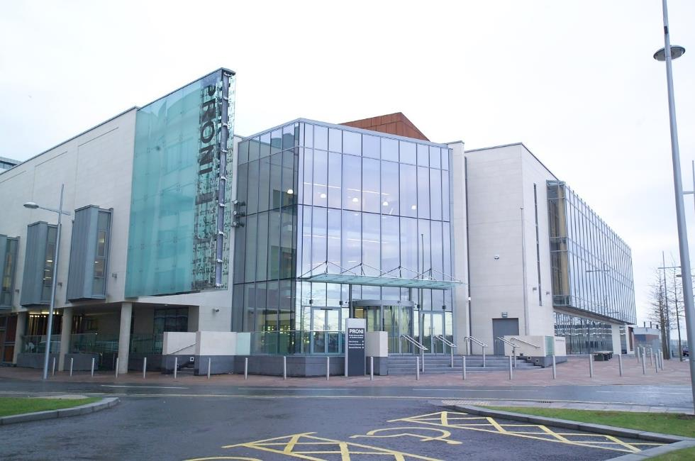
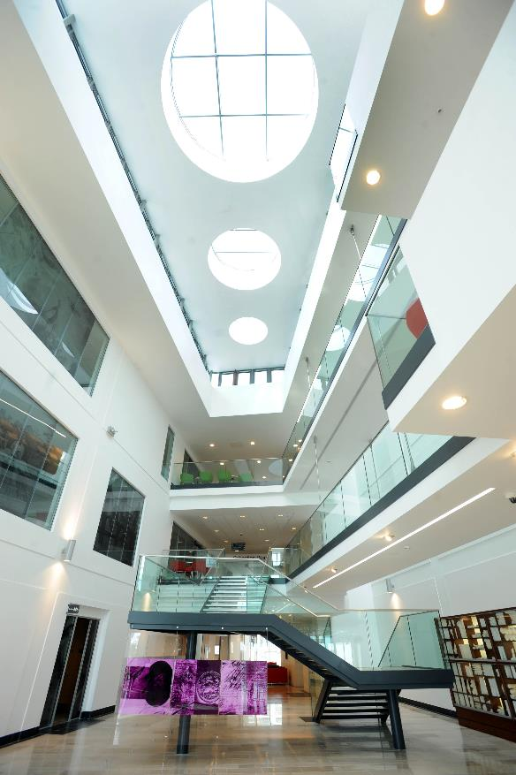
The Public Record Office of Northern Ireland (PRONI)

Slide 3
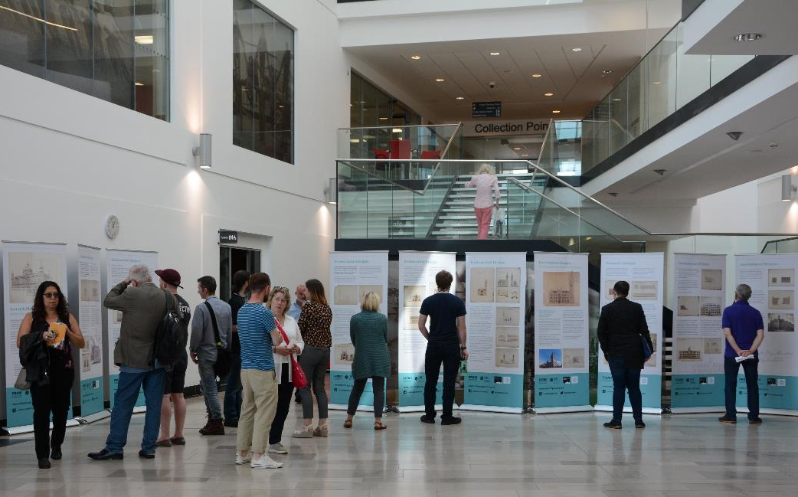
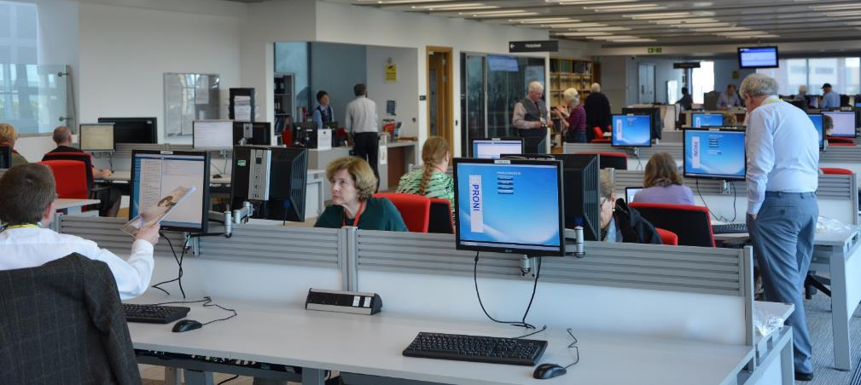
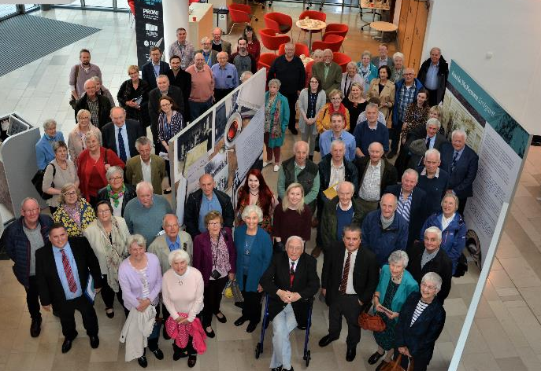

Slide 4
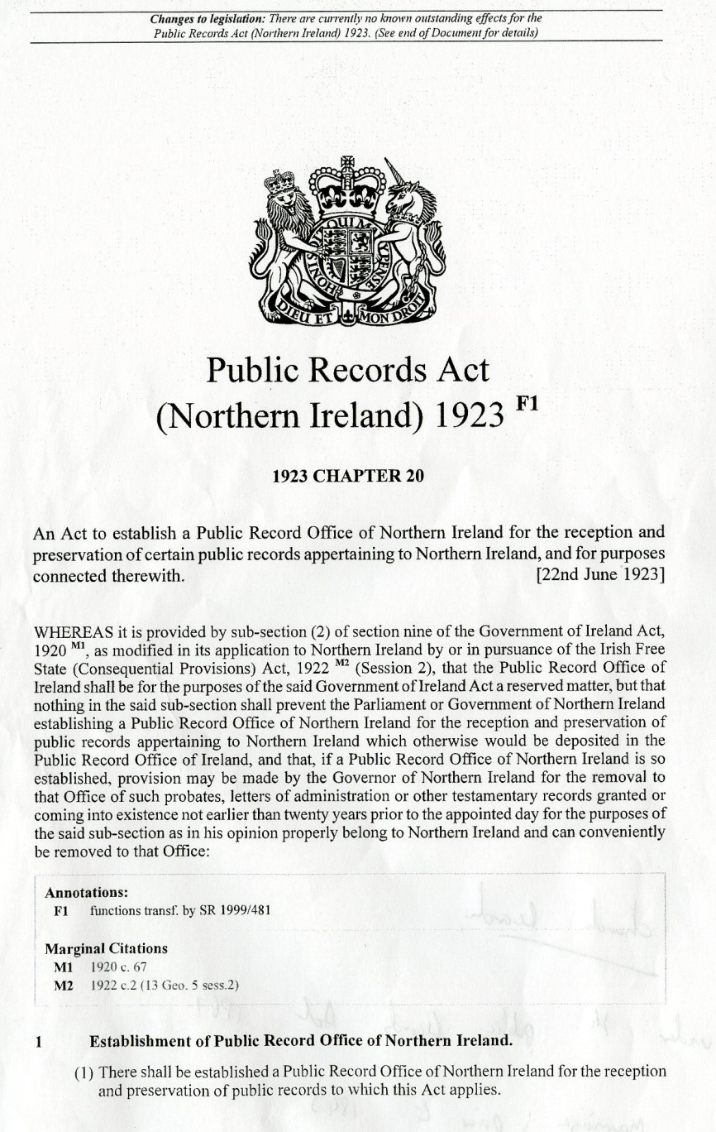
PRONI – Public Records Act (NI) 1923
Disposal of Documents Orders 1925
Data Protection Legislation
Freedom of Information Act 2000

Slide 5
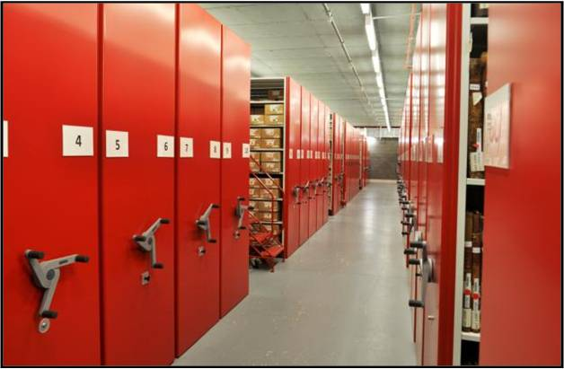
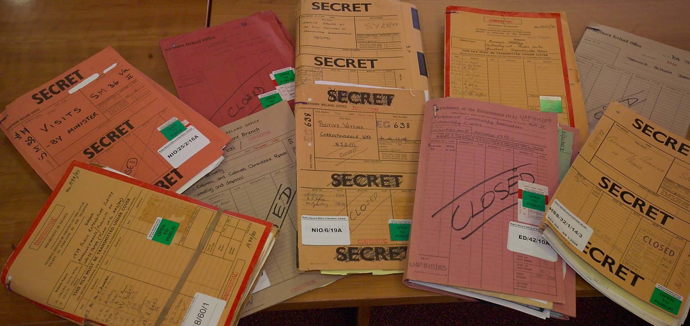
Economy – De Lorean
Health - Aids, abortion
Social – Housing, infrastructure, recreation
Education – Integrated, Irish language
Environment – Chernobyl
Agriculture – EU subsidies
Notes/minutes of meetings
Briefings
Correspondence
Memos
Reports

Slide 6
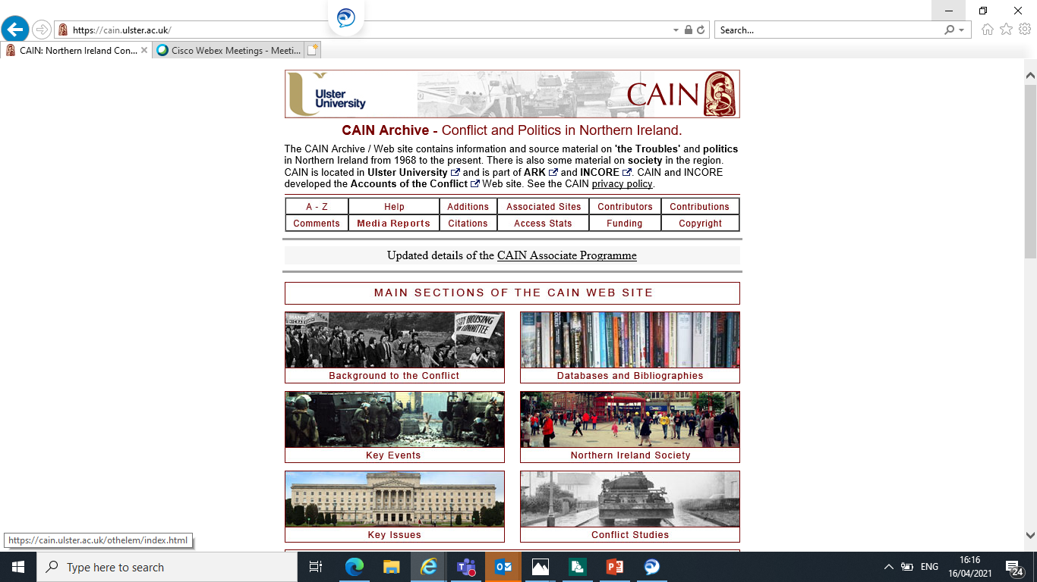
Using CAIN
Chronology of the Conflict
– timeline of events
Content – Key resources
– Sutton Index of Deaths
Cooperation – Events

Slide 7
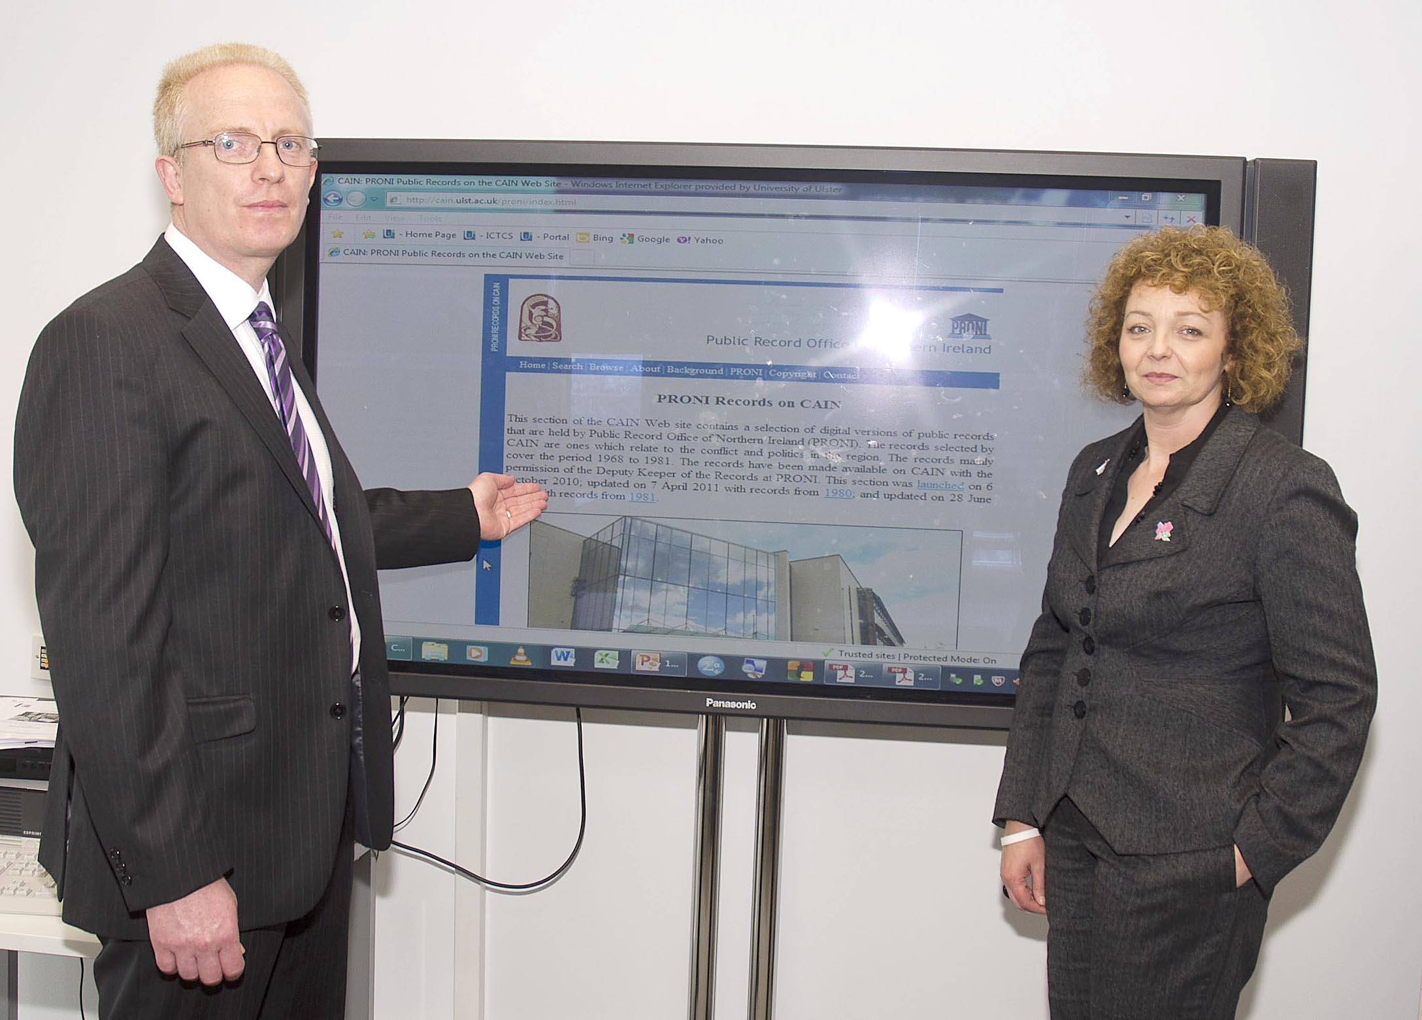
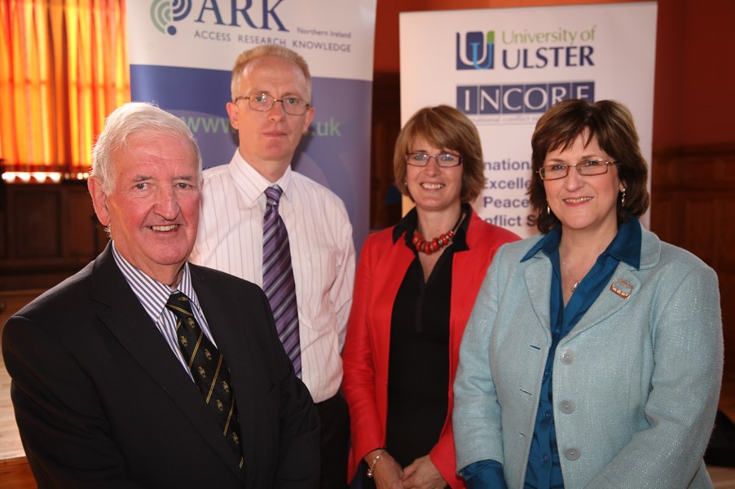
C
PRONI on CAIN launch of 1981 documents -2012 Launch of PRONI on CAIN - 2010

Slide 8
3 Oct. 1968 William Craig, Minister of Home Affairs, prohibiting the holding on Saturday 5 October 1968, of all public processions or meetings within and on the Walls and in the Waterside Ward…
4 Oct. 1968 Greeves, Home Affairs to Woods, Home Office, …the CRA is composed largely of people opposed to the Constitution of NI – and, despite its title, is regarded by many – and rightly so – as having aims which are largely Nationalistic…

Slide 9
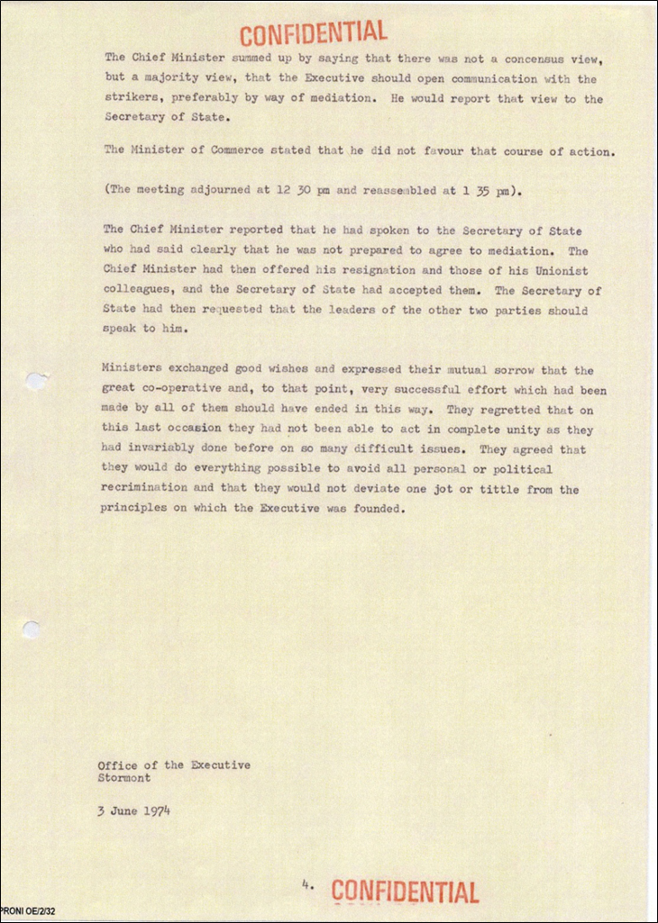
28 May 1974 – ‘Ministers exchanged good wishes and expressed their mutual sorrow that the great cooperative work, to that point, very successful effort which had been made by all of them should have ended in this way. They regret that on this last occasion they had not been able to act in complete unity as they had invariably done before on so many different issues. They agreed that they would do everything possible to avoid all personal or political recrimination…’
https://cain.ulster.ac.uk/proni/1974/proni_OE-2-32_1974-05-28.pdf

Slide 10
Letter found during a wing move from H3 block on 15 Feb. 1981, from Bobby Sands about another H/S which shall commence on March 1^{st.}
Record of 1st meeting 11 Dec. 1985, Mr King ‘…the reaction of unionists had been more hostile than expected.’

Slide 11
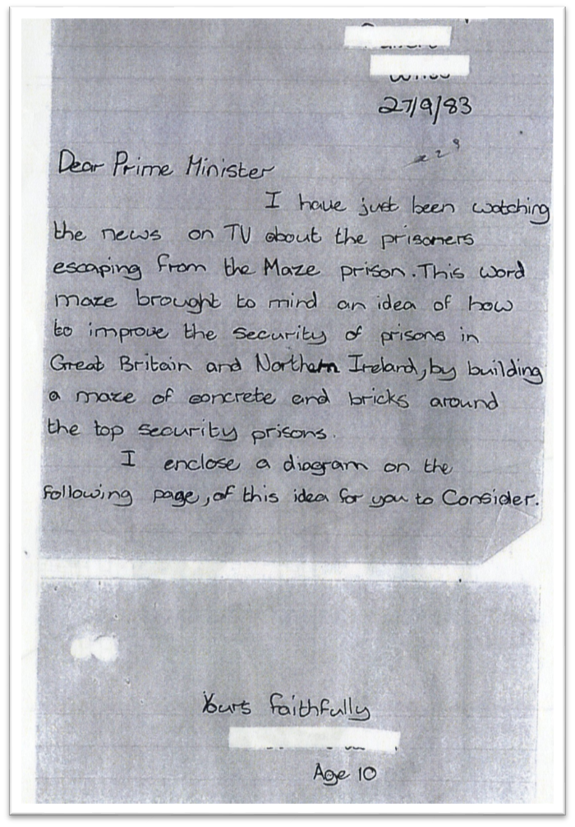
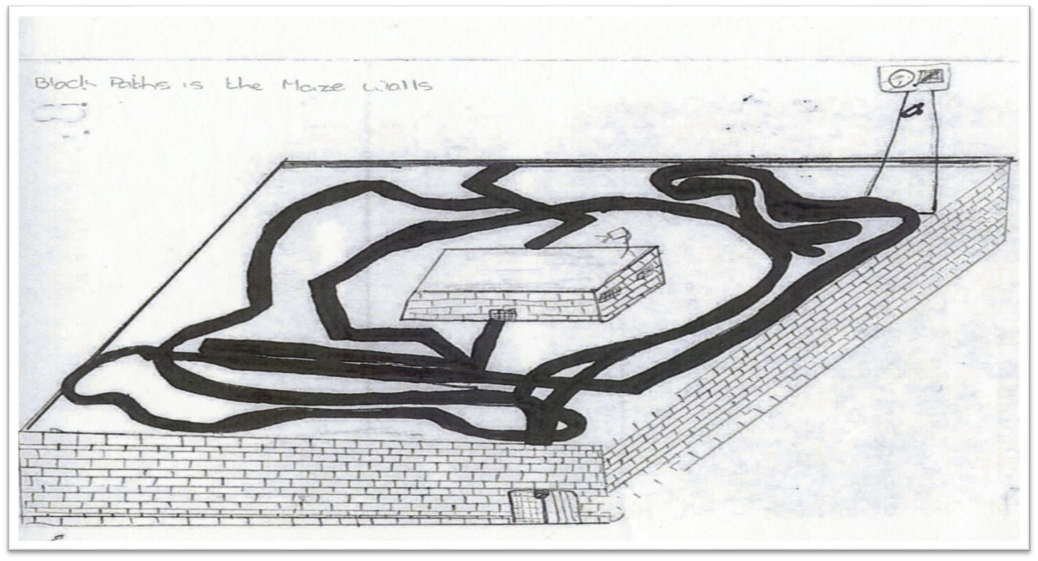
Prisons: Escapes from HM Prison Maze: Correspondence
NIO/12/514A

Slide 12
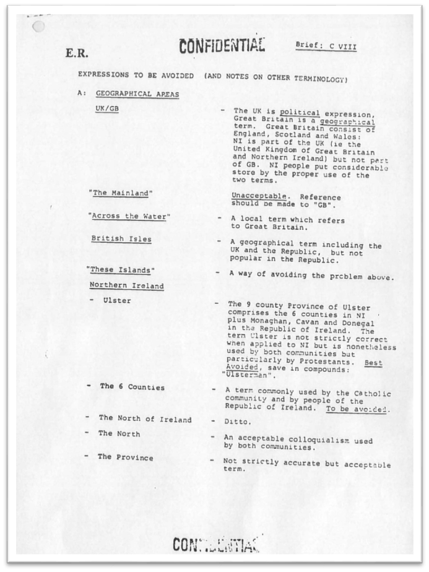
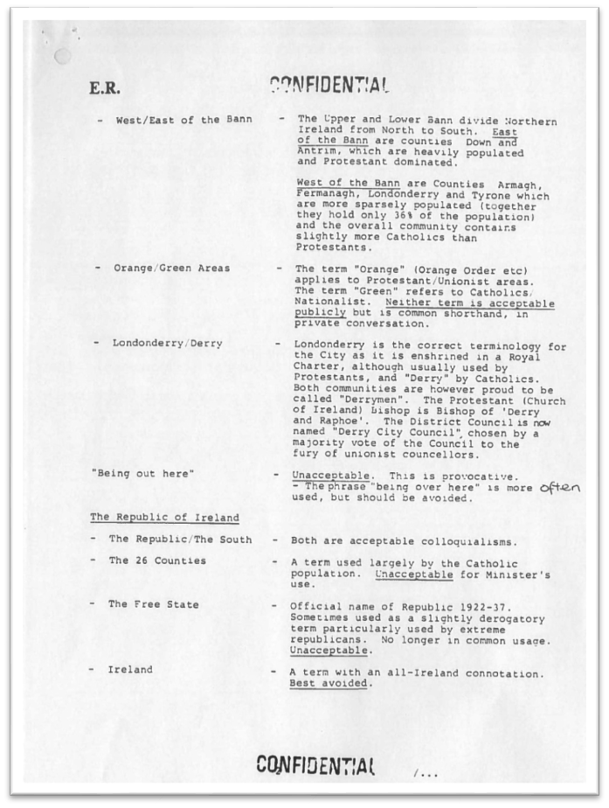
https://cain.ulster.ac.uk/proni/1984/proni_CENT-1-13-29A_1984-09-nd.pdf
‘The Mainland’ – Unacceptable
‘Being out here’ – Unacceptable
‘Ireland’ – Best avoided
‘The Republic/The South’ – Acceptable
‘Prods’ – Unacceptable
‘Republicans’ – To be avoided
‘Taioseach’ (pronounced Teeshuck) - Acceptable
‘British Army’ – Unacceptable
‘Long Kesh’ - Unacceptable

Slide 13
17 June 1991 – Speech of John Hume to the First Plenary Session of Strand 1 of the Talks (CENT/1/20/51A)
‘Our community has been in turmoil for almost a quarter of a century. The statistics of the dead and the maimed have been rehearsed so often, that we have become desensitised as a community to the full horrors of the pain and suffering they represent.’
Stable relationships have never existed between the peoples represented around this table…We have been quick to lay blame, and adamantly unforgiving.
We have never been short of extremists who believe that force is the answer. That violence is the only effective means of settling matters.
If we are to succeed in resolving our differences. Then we must face those differences honestly and directly…Neither of us can change what we are. What we can, and must, change are our attitudes, our intolerance of difference, our repeating pushing of difference to the point of division. We must being by accepting each other for what we are, accepting that we each have an absolute right to be what we are and that we cannot, either of us, change, what we are…’
https://cain.ulster.ac.uk/proni/1991/proni_CENT-1-20-51A_1991-06-17d.pdf

Slide 14
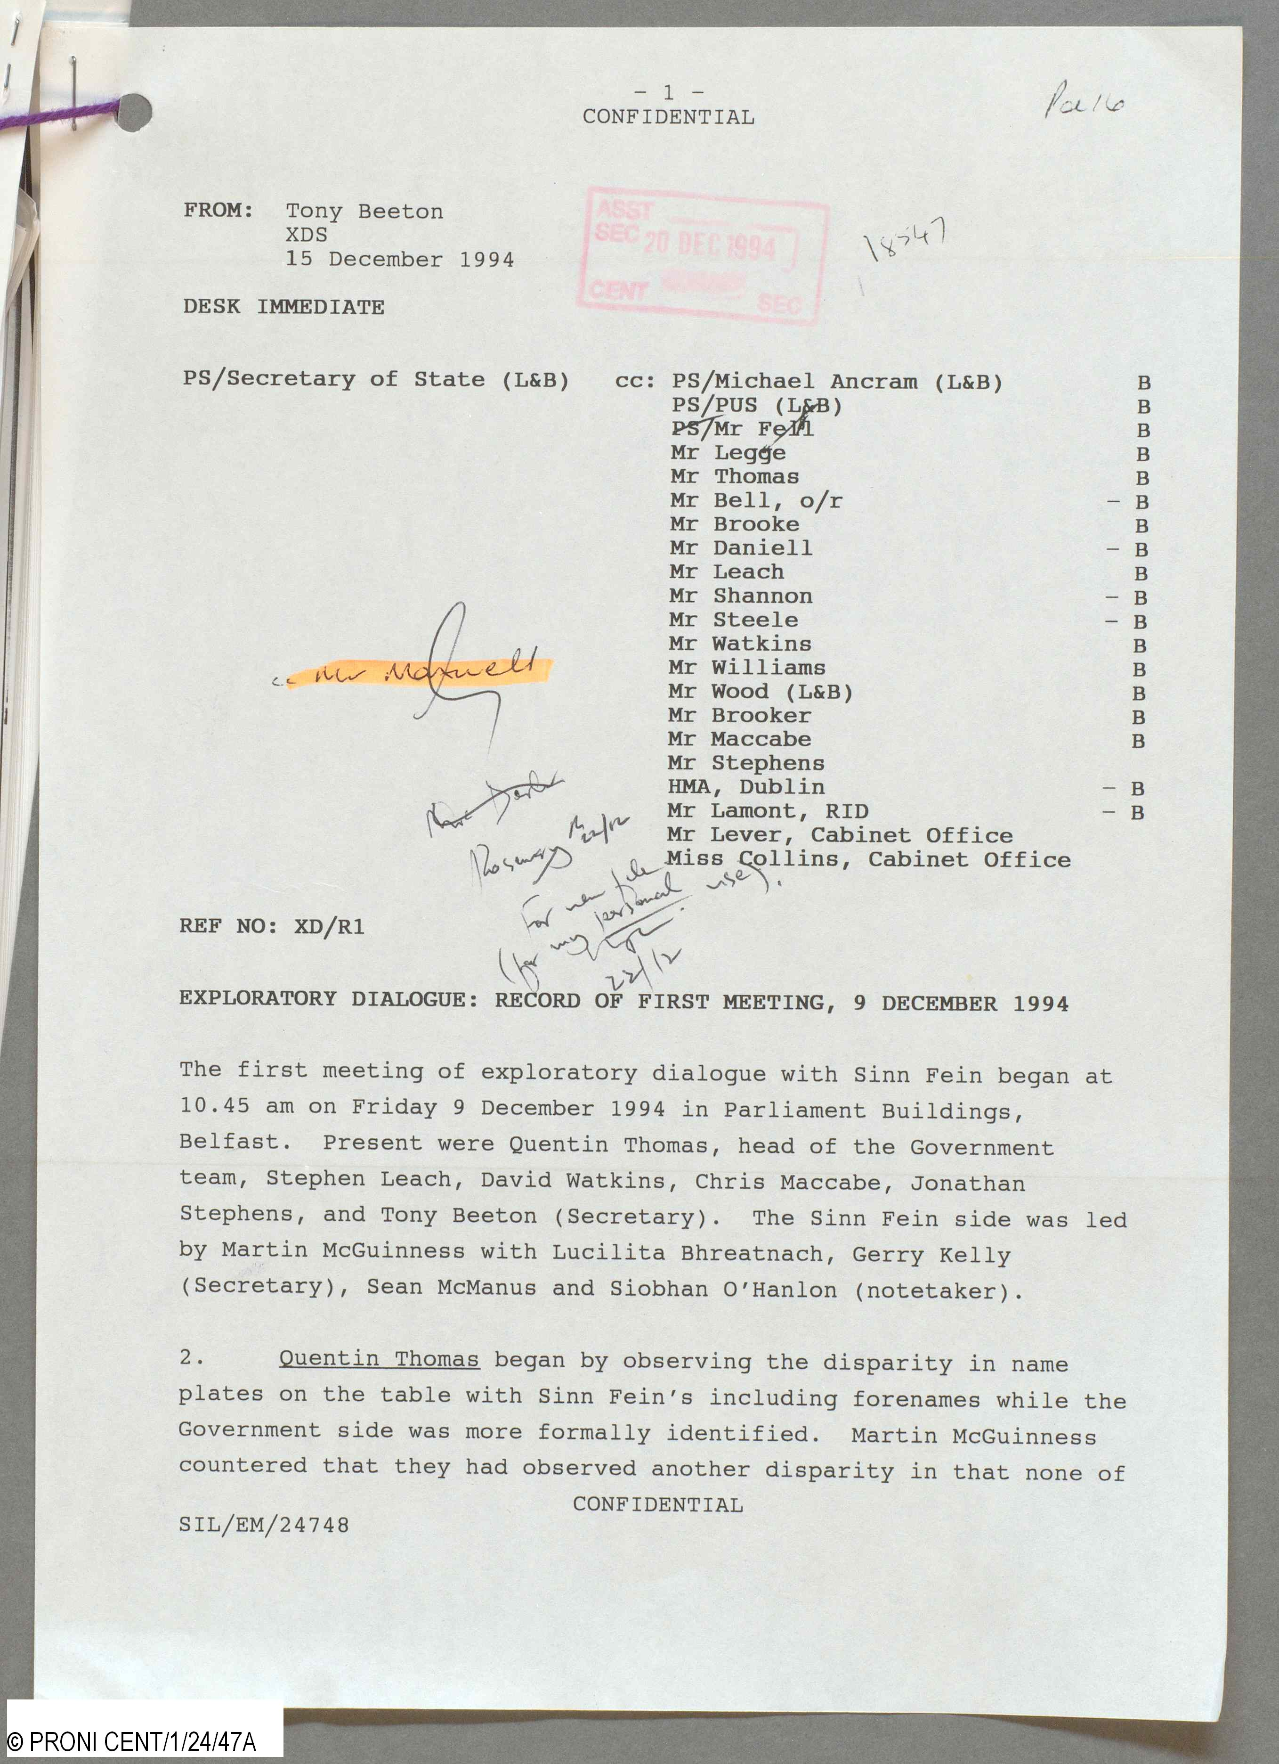
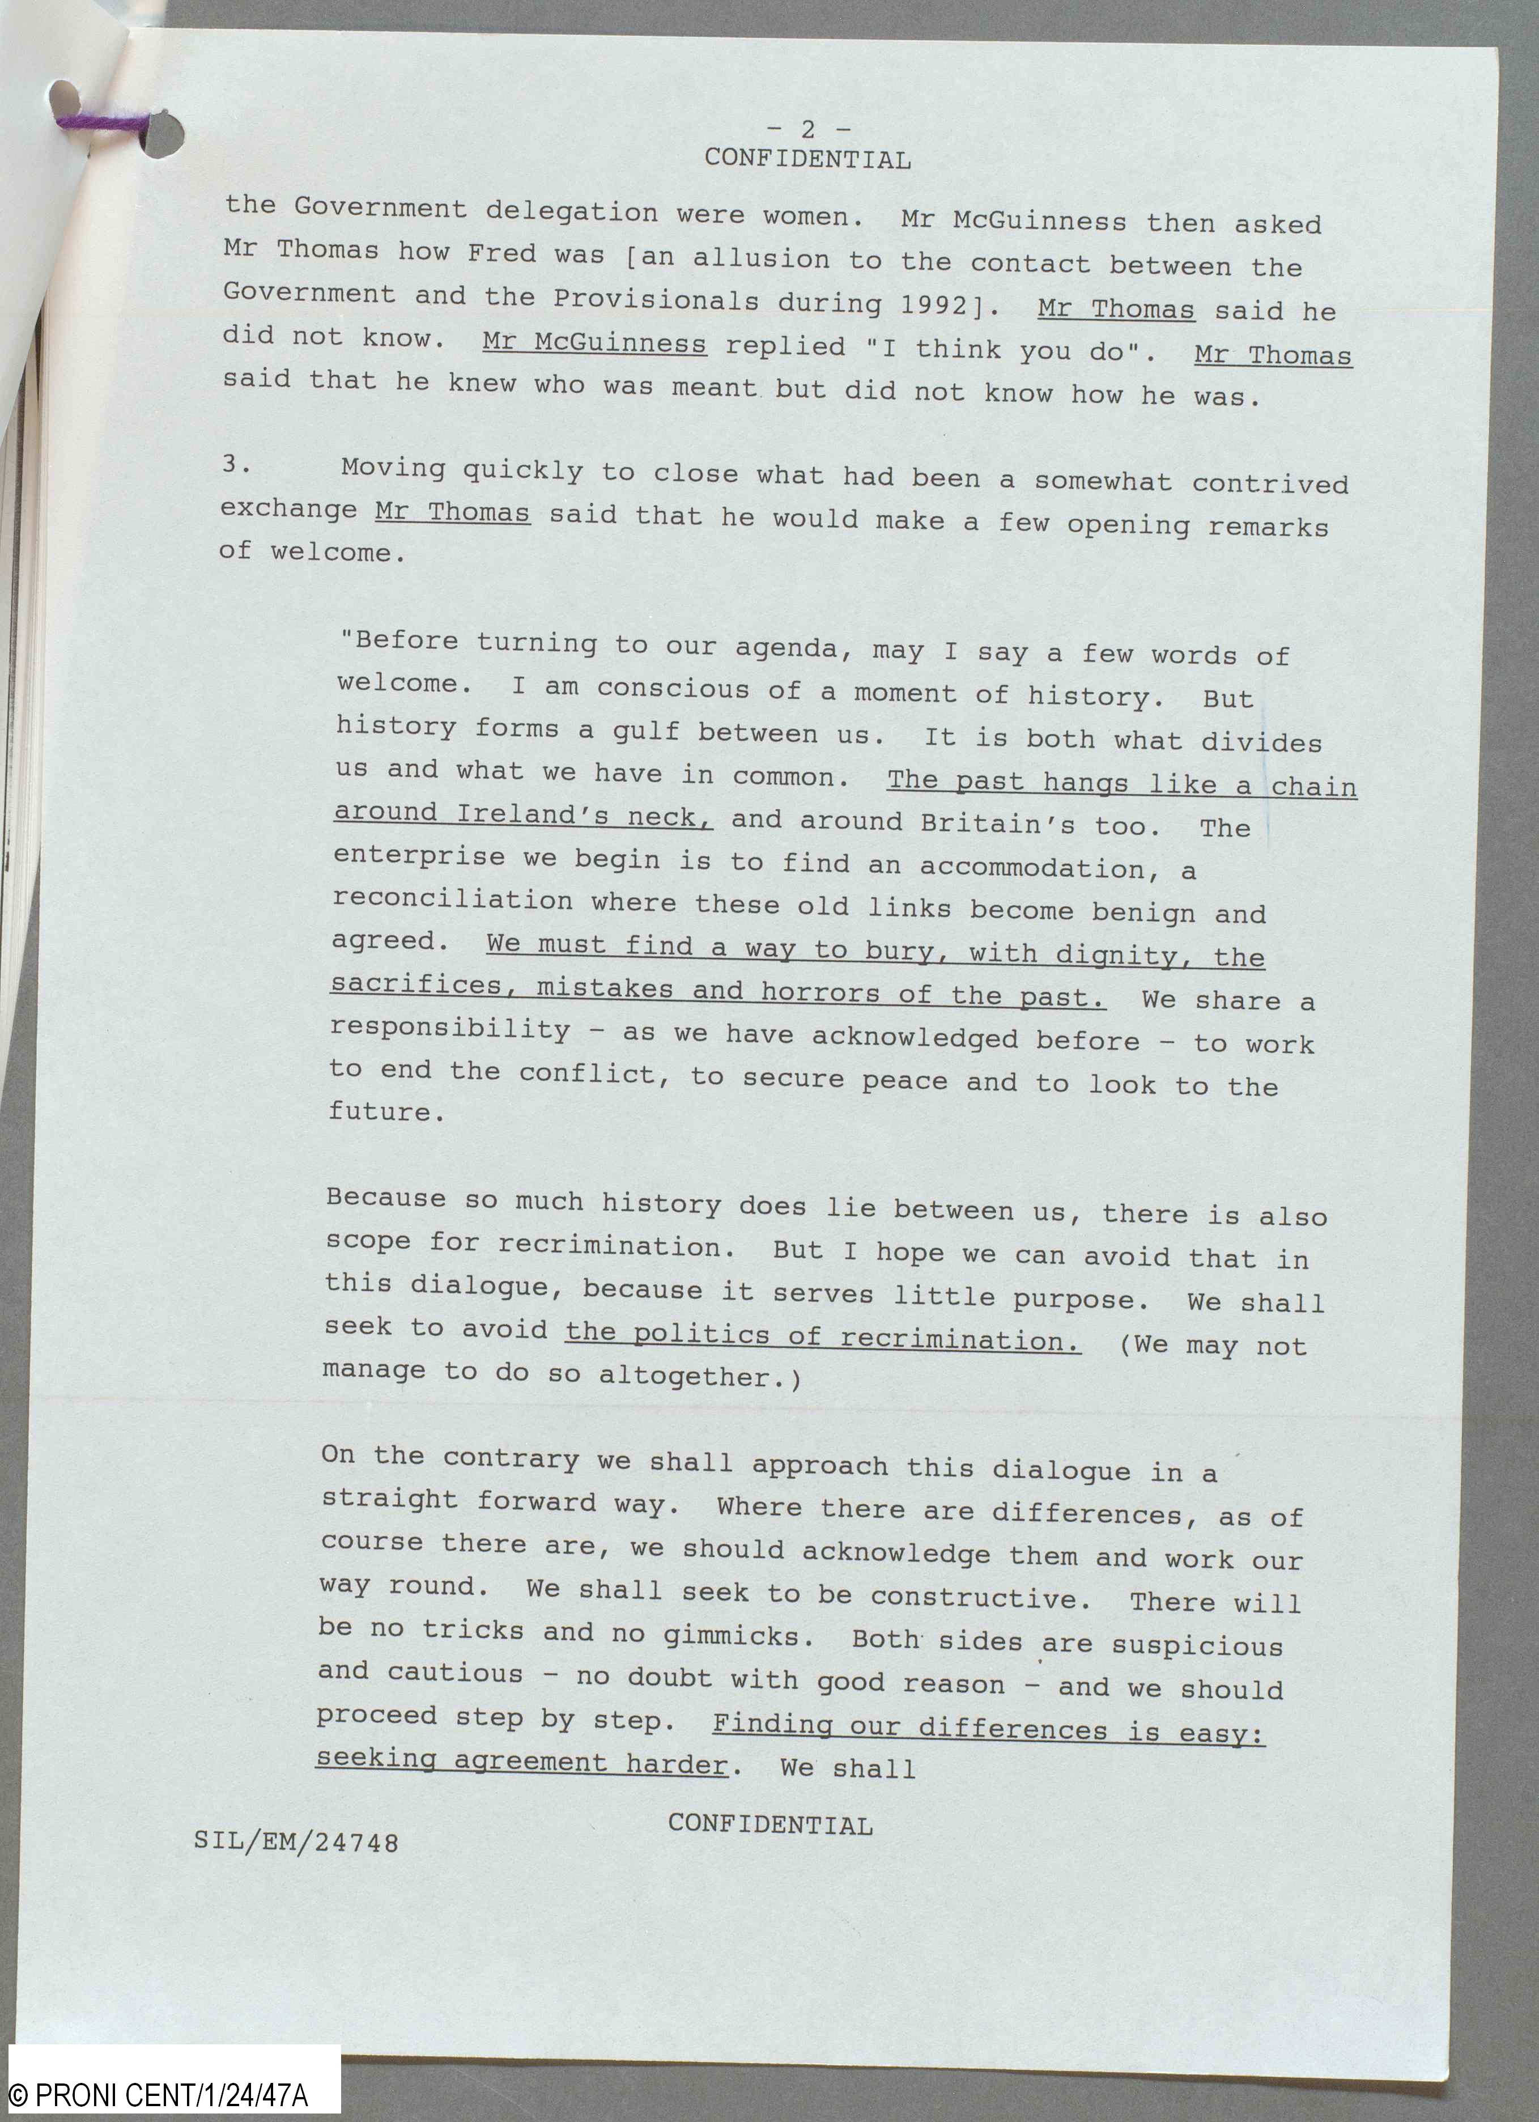
Mr
Record of first meeting with Sinn Fein – 9 December 1994
…Mr McGuinness then asked Mr Thomas how Fred was (an allusion to the contact between the Government and the Provisionals during 1992). Mr Thomas said he did not know. Mr McGuinness replied ‘I think you do’. Mr Thomas said that he knew who was meant but did not know how he was.’
‘I am conscious of a moment of history…The past hangs like a chain around Ireland’s neck.’

Slide 15
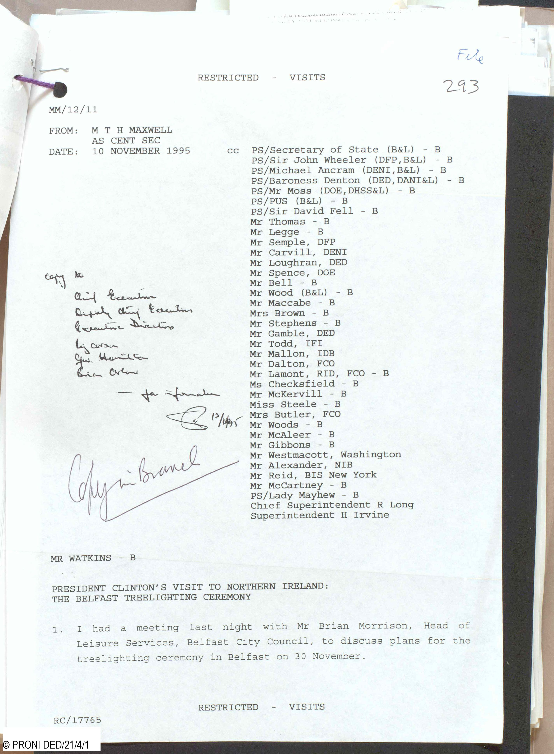
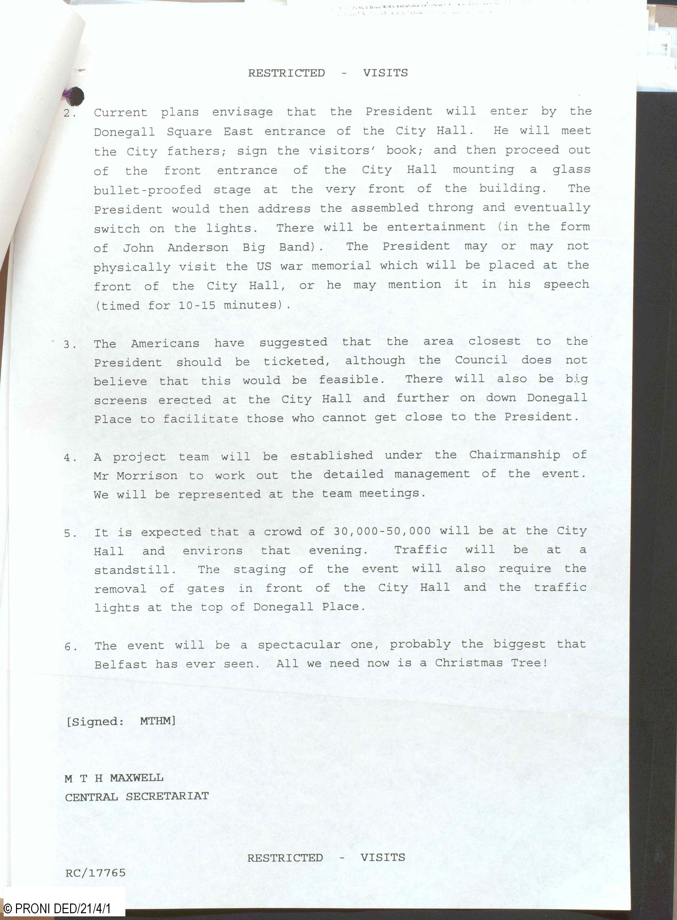
Mr
Central Secretariat memo – 10 November 1995 – President Clinton’s visit to NI. The Belfast Treelighting Ceremony.
‘The event will be a spectacular one, probably the biggest Belfast has ever seen. All we need now is a Christmas Tree!’

Slide 16
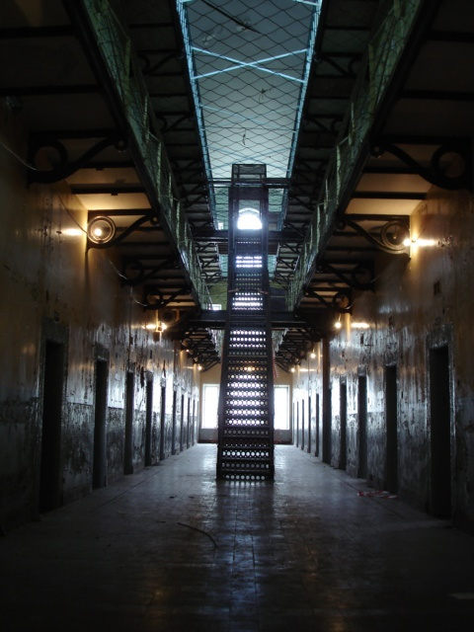
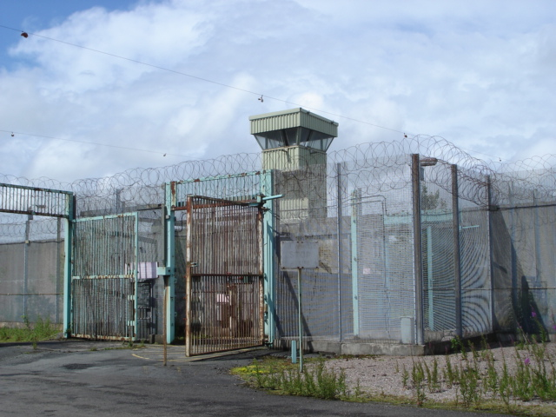
Oral History Archive/Stormont House Agreement
(images courtesy of the Prisons Memory Archive D4616)

Slide 17
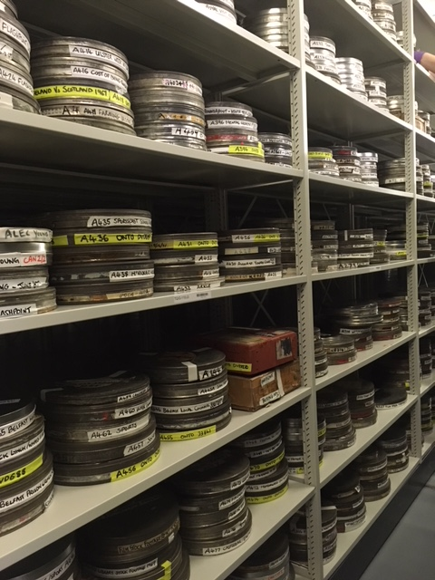
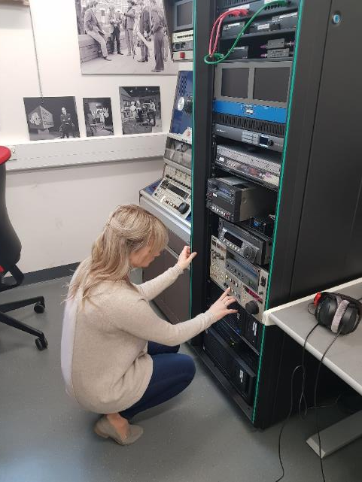
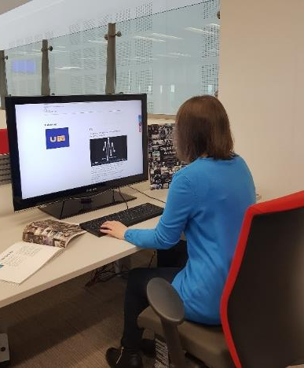
UTV Film and Tape Archive (D4677) partnership with NI Screen and ITV

Slide 18
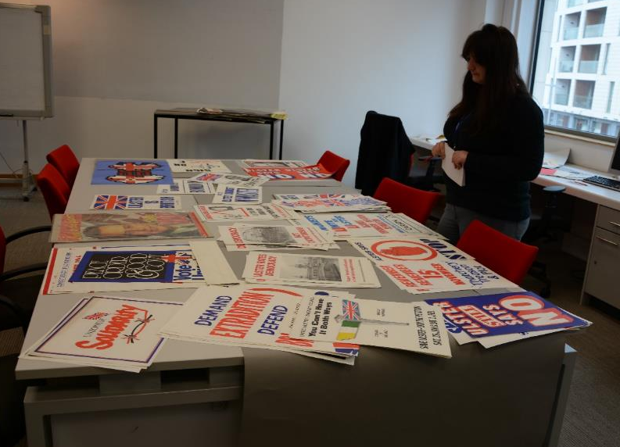
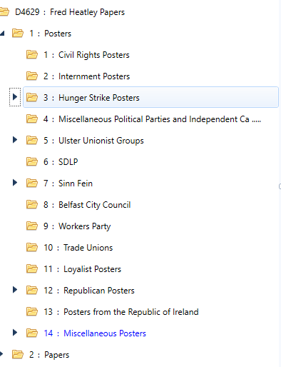
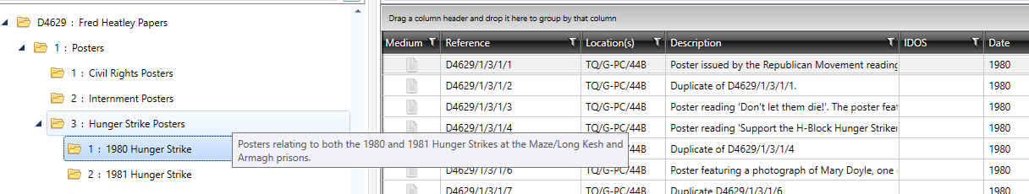
PRONI and CAIN

Slide 19

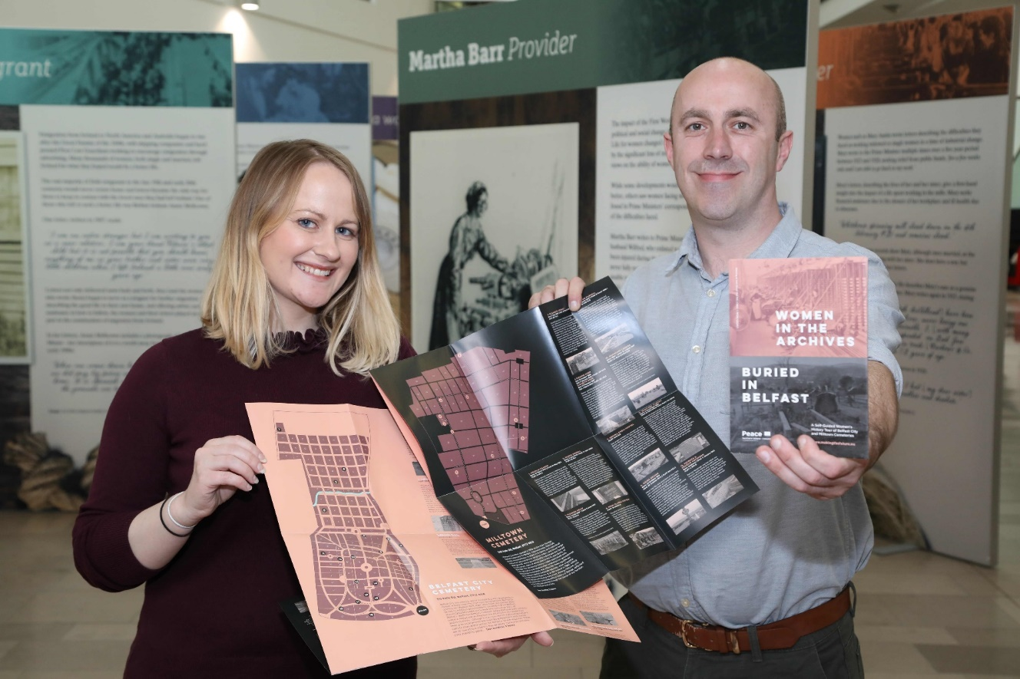
PRONI and CAIN
Partnerships and participation – Making the Future https://www.makingthefuture.eu/project-info/women-in-the-archives and https://www.makingthefuture.eu/project-info/100-shared-stories
Commemoration

Slide 20
PRONI and CAIN
Why we keep and use archives
To protect the archival memory of our society
To support accountability of government and public bodies
To ensure compliance with legislation – Access to information
To provide evidence of the activities, rights, transactions of individuals, groups, communities

Slide 21

Email: access@communities-ni.gov.uk
Website: www.nidirect.gov.uk/proni
Facebook: www.facebook.com/publicrecordofficeni
Twitter: follow @PRONI_DFC to keep up to date with PRONI‎
If you want to be added to our mailing list and kept informed about PRONI news and events, please email proni@communities-ni.gov.uk

Slide 22



